Slide 1





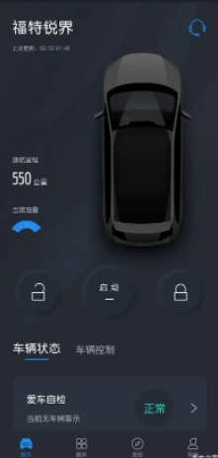
ECG
z
Legend:
Drive Video Record
Feature Scope
Integrated Dash Camera Module (IDCM)
In Vehicle
Out Vehicle
Vehicle Battery
Vehicle Data
In IDCM
Wi-Fi
Power Manager
LVDS
Serializer
(FPDLink)
CAN
Customer
Live View
Replay
AR Video
IVI System
Environment
LVDS Coax
Power Input
LVDS
Video
Power
I2C
UART
Setting Control
Video Control
Status Sync
Control ACK
Setting Control
Video Display Control
Windshield
Video/Photo display
IDC & AR
Camera
Video Input
TF Card
Manager
Data Copy via TF card pull out
SWDL
eMMC
Customer
Exterior
Environment
G-Sensor
Crash Detect
Setting Control
Video Control
SWDL
Ford APP
Wi-Fi
Manager
Setting Control
Video Display Control
Setting ACK
Control ACK
Data Copy
Video/Photo display

Slide 2
Other ECU
z
Drive Video Record (DVR) Feature Scope
ECG
Integrated Dash Camera Module (IDCM)
SWDL
Diagnostic
Setting
Video Control
CAN Controller
IVI System
Vehicle Battery
Vehicle Info Input
Setting ACK
Control ACK
Setting Control
Video Control
Power Manager
LVDS
Power Input
Live View
Replay
AR Video
Windshield
Video Input
IDC & AR
Camera
TF Card
Encode
Data Copy
Exterior
Environment
Customer
eMMC
Crash Detect Input
G-Sensor
Decode
Encode
Decode
Setting
Video Control
Ford APP
Setting Control
Video Control
Data Copy Input
Legend:
Wi-Fi
Wi-Fi
In Vehicle
Option Module
Setting ACK
Control ACK
Data Copy Output
In ECU
Out Vehicle
CAN Data
Wi-Fi Connection
Env Exchange
Customer Operation
Video Input
Video Output

Slide 3


Other ECU
In Vehicle
z
Drive Video Record (DVR) Feature Scope
ECG
SWDL
Diagnostic
Vehicle Info
Integrated Dash Camera Module (IDCM)
Setting
Error Report
CAN Controller
IVI System
Setting
Menu Control
Voice Control
Gesture Control
Data Replay
Exterior
Environment
G-Sensor
LVDS
Crash Detect
Preview
Replay
Windshield
IDC & AR
Camera
TF Card
Data Copy
Encode
Video Input
Customer
Veh Battery
eMMC
Power Manager
Decode
Power Input
Encode
Ford APP
Setting
Data DL
Data Replay
Wi-Fi
Legend:
Mic
(Removed)
LED
(Removed)
Wi-Fi
In Vehicle
Option Module
Preview
Replay
Download
In ECU
Out Vehicle
CAN Data
Wi-Fi Connection
Env Exchange
Customer Operation
Sound Detect
Video Input
Video Output

